Slide 1
Let’s get
MAD
Unity Week NZ 15-21 March

Slide 2
MAD stands for...
Making
A
Difference
in the Community!
Unity Week NZ, 15 – 21 March
unityweek.co.nz
Notes:
A Design-thinking approach to Social Action

Slide 3
How might we …
make a difference in our community?
Unity Week NZ, 15 – 21 March
unityweek.co.nz
Notes:
What are some of the challenges or threats to unity, inclusion, and social cohesion in our community?

Slide 4
Our Community
What is does our community look like?
Who is part of our community?
What are the challenges to unity and social cohesion within our community?
What are the special and unique characteristics of our community?
Unity Week NZ, 15 – 21 March
unityweek.co.nz
Notes:
SE

Slide 5
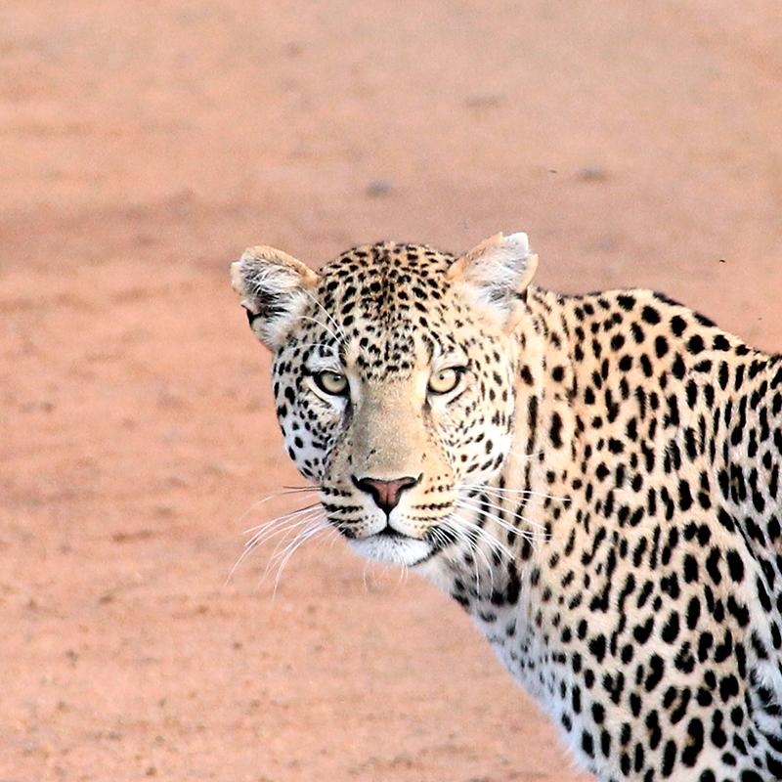
Let’s get MAD
Unity Week NZ 15 to 21 March
Design Thinking Challenge
How might we …
make a difference in our community?
Notes:
The learning contained in this PPT is multifaceted - it is about:
Learning the Design-thinking Model
Grappling with the key themes and messages of Unity Week
Working collaboratively - in unison with peers to make a difference in the community
An introduction to Inquiry and Social Action

Slide 6
MAD Week is about...
Student leadership
Collaborating
Being empathetic
Problem solving
Being creative and innovative!
Unity Week NZ, 15 – 21 March
unityweek.co.nz
Notes:
PRJ

Slide 7
Design Thinking...
Unity Week NZ, 15 – 21 March
unityweek.co.nz
Notes:
SE

Slide 8
Design Thinking...
Notes:
Design Thinking Model created by Philippa Nicol - CORE Education

Slide 9
Design Thinking...
Immersion
Ideation
Implementation
Unity Week NZ, 15 – 21 March
unityweek.co.nz

Slide 10
Immersion...

Slide 11
Immersion...
What are some of the challenges or threats to unity, inclusion, and social cohesion in our community?
Unity Week NZ, 15 – 21 March
unityweek.co.nz

Slide 12
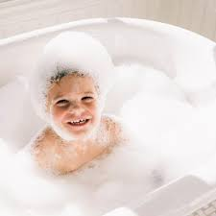
Immersion...
Unity Week NZ, 15 – 21 March
unityweek.co.nz
Notes:
Bubble baths are something that we want to spend time ‘luxuriating’ in - not something we just want to dip our toe into and then move on quickly. Although it is not always easy to spend time focusing on challenges/threats which can be uncomfortable or provocative, it is worth time thinking about the challenges so that we can develop a meaningful and empathetic response.

Slide 13
Immersion...
Unity Week NZ, 15 – 21 March
unityweek.co.nz
Notes:
Of all of the challenges that we have thought of, which one [which threat, challenge, opportunity] are we as a collective, most passionate about? Passion drives motivation and a desire to make a positive difference.

Slide 14
How might we …
make a difference in our community?
Unity Week NZ, 15 – 21 March
unityweek.co.nz
Notes:
How might we make our community feel/be more unified, inclusive and socially cohesive?

Slide 15
Immersion is about..
Knowing the parameters of our challenge deeply
Understanding our challenge from our Stakeholder’s perspective
Research
Gathering information
Unity Week NZ, 15 – 21 March
unityweek.co.nz

Slide 16
Unity Week NZ, 15 – 21 March
unityweek.co.nz
Notes:
An opportunity to teach about the value of empathy.

Slide 17
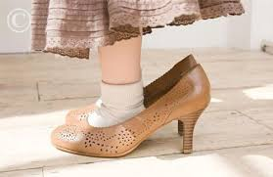
Walking in somebody else’s shoes...
Empathy
Unity Week NZ, 15 – 21 March
unityweek.co.nz

Slide 18
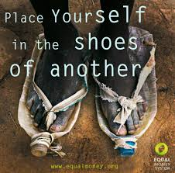
Unity Week NZ, 15 – 21 March
unityweek.co.nz

Slide 19
Empathy is not sympathy.
Nor is it feeling sorry for others.
Instead, it is understanding
what others are thinking
and feeling.
Unity Week NZ, 15 – 21 March
unityweek.co.nz

Slide 20
How might we …
make a difference in our community?
Unity Week NZ, 15 – 21 March
unityweek.co.nz
Notes:
The idea is to keep the ‘How might we…’ question frame and to complete the Inquiry question with the specifics of your community-based challenge.
For example: How might we ensure that people from all ethnicities and cultural backgrounds feel welcome and included at our school?
It is important NOT to assume/insert a predetermined social action at this point. This will ‘fall out’ of the ideation phase.
NOT: How might we design a social media campaign to publicise a wide variety of cultural greetings to model inclusivity? We don’t yet know that a social media campaign is going to be ‘fit-for-purpose’. Nor do we know that ignorance of cultural greetings is the barrier to inclusivity.

Slide 21
How - open-ended, limitless possibilities, open-minded…
Might - the power of possibilities, options, choices, considerations…
We - inclusive, shared ownership...
Unity Week NZ, 15 – 21 March
unityweek.co.nz

Slide 22
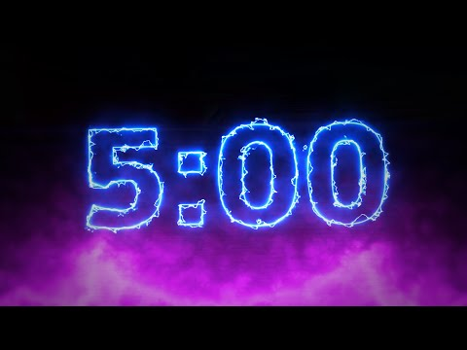
What are some issues, challenges or problems that your class is very passionate about?
Unity Week NZ, 15 – 21 March
unityweek.co.nz
Notes:
An opportunity for them to talk, brainstorm, throw ideas around…

Slide 23
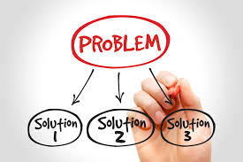
Ideation...
Unity Week NZ, 15 – 21 March
unityweek.co.nz
Notes:
Only after Immersion are you thinking about coming up with ideas for social action(s) - these are based on what you’ve “discovered” during the immersion phase.

Slide 24
Ideation is about..
Considering LOTS of different possibilities
“Blue Sky” Thinking
Looking for new/innovative “solutions”
Thinking outside the box!
Daring to go there!
Unity Week NZ, 15 – 21 March
unityweek.co.nz

Slide 25
Ideation...
Unity Week NZ, 15 – 21 March
unityweek.co.nz

Slide 26
Ideation is about..
Considering the “needs” and “desires” of our Stakeholders
Being empathetic!
Being creative!
Being solution focused!
Unity Week NZ, 15 – 21 March
unityweek.co.nz

Slide 27
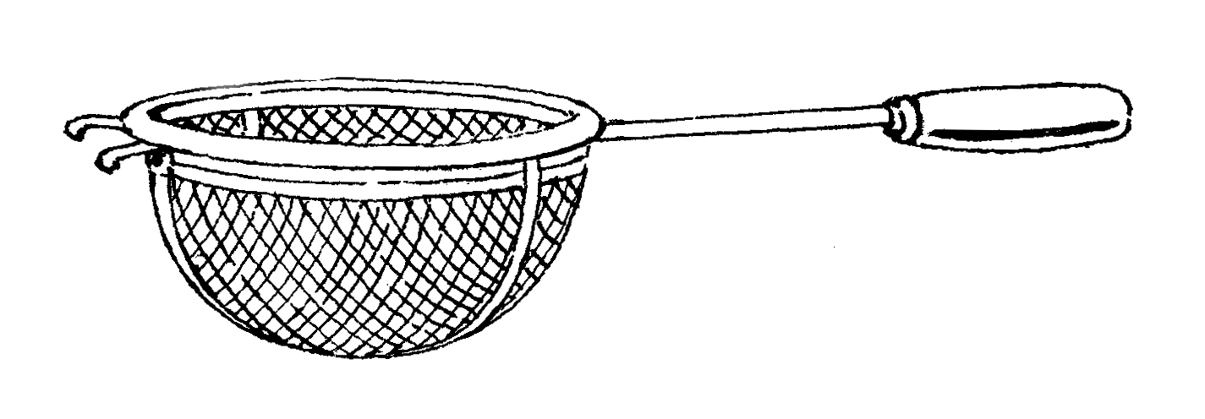
Filtering ideas...
Are the ideas/solutions innovative, feasible or effective?
Unity Week NZ, 15 – 21 March
unityweek.co.nz
Notes:
An important step in the process of selecting/agreeing upon a Social Action.

Slide 28
Filtering ideas...
Innovative?
Is it creative, fresh or new?
Feasible?
Is it practical or worthwhile?
Effective?
Would it “make a difference” (MAD)?
Unity Week NZ, 15 – 21 March
unityweek.co.nz
Notes:
This process of filtering ideas is an excellent opportunity for learners to experience the skill of reaching a consensus. Ideally, group members should have an opportunity to select and ‘pitch’ their safe bet, long shot and darling ideas before the group strives to reach a compromise. This sub-activity relates strongly to the themes of Unity Week itself.

Slide 29
This idea/solution could definitely work.
Safe Bet
Unity Week NZ, 15 – 21 March
unityweek.co.nz

Slide 30
Great idea/solution BUT risky - it might work, but it might not.
Long Shot
Unity Week NZ, 15 – 21 March
unityweek.co.nz

Slide 31
Love this idea!! It is super exciting.
Darling!
Unity Week NZ, 15 – 21 March
unityweek.co.nz

Slide 32
Implementation...
Unity Week NZ, 15 – 21 March
unityweek.co.nz

Slide 33
Implementation...
Unity Week NZ, 15 – 21 March
unityweek.co.nz

Slide 34
Implementation...
Unity Week NZ, 15 – 21 March
unityweek.co.nz
Notes:
This links forward to the Level 1 Social Studies ideas of decision-making and an awareness that a decision/action could be a solution or a resolution.

Slide 35
Implementation...
Unity Week NZ, 15 – 21 March
unityweek.co.nz

Slide 36
Implementation...
Notes:
This links forward to the Level 1 Social Studies ideas of decision-making and an awareness that a decision/action could be a solution or a resolution.

Slide 37
Unity Week NZ, 15 – 21 March
unityweek.co.nz
Notes:
PRJ

Slide 38
How might we …
make a difference in our community?
Unity Week NZ, 15 – 21 March
unityweek.co.nz
Notes:
Un-pack the How...might...we…
How = open-ended, limitless possibilities, open-minded…
Might = the power of possibilities, options, choices, considerations…
We = inclusive, shared ownership...

Slide 39
Get MAD this
Unity Week NZ 15-21 March
unityweek.co.nz

